Slide 1

Notes:
Intro: ye project do datasets ko ek dashboard me jodta hai.

Slide 2
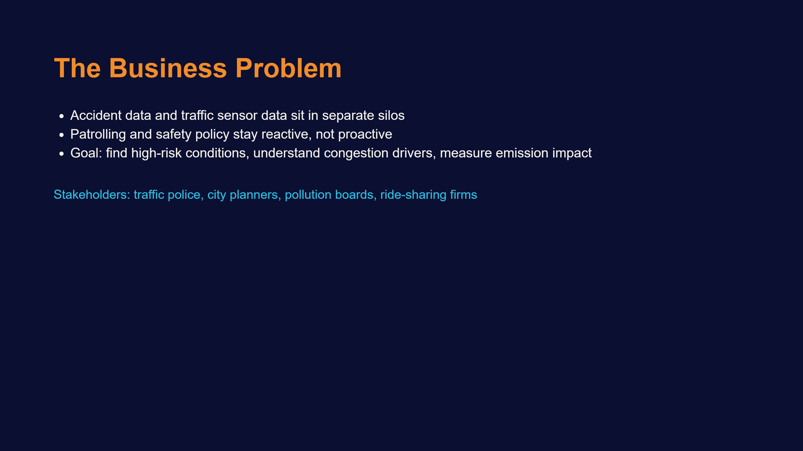
Notes:
Pehle batao problem kya thi aur kiske liye analysis hai.

Slide 3
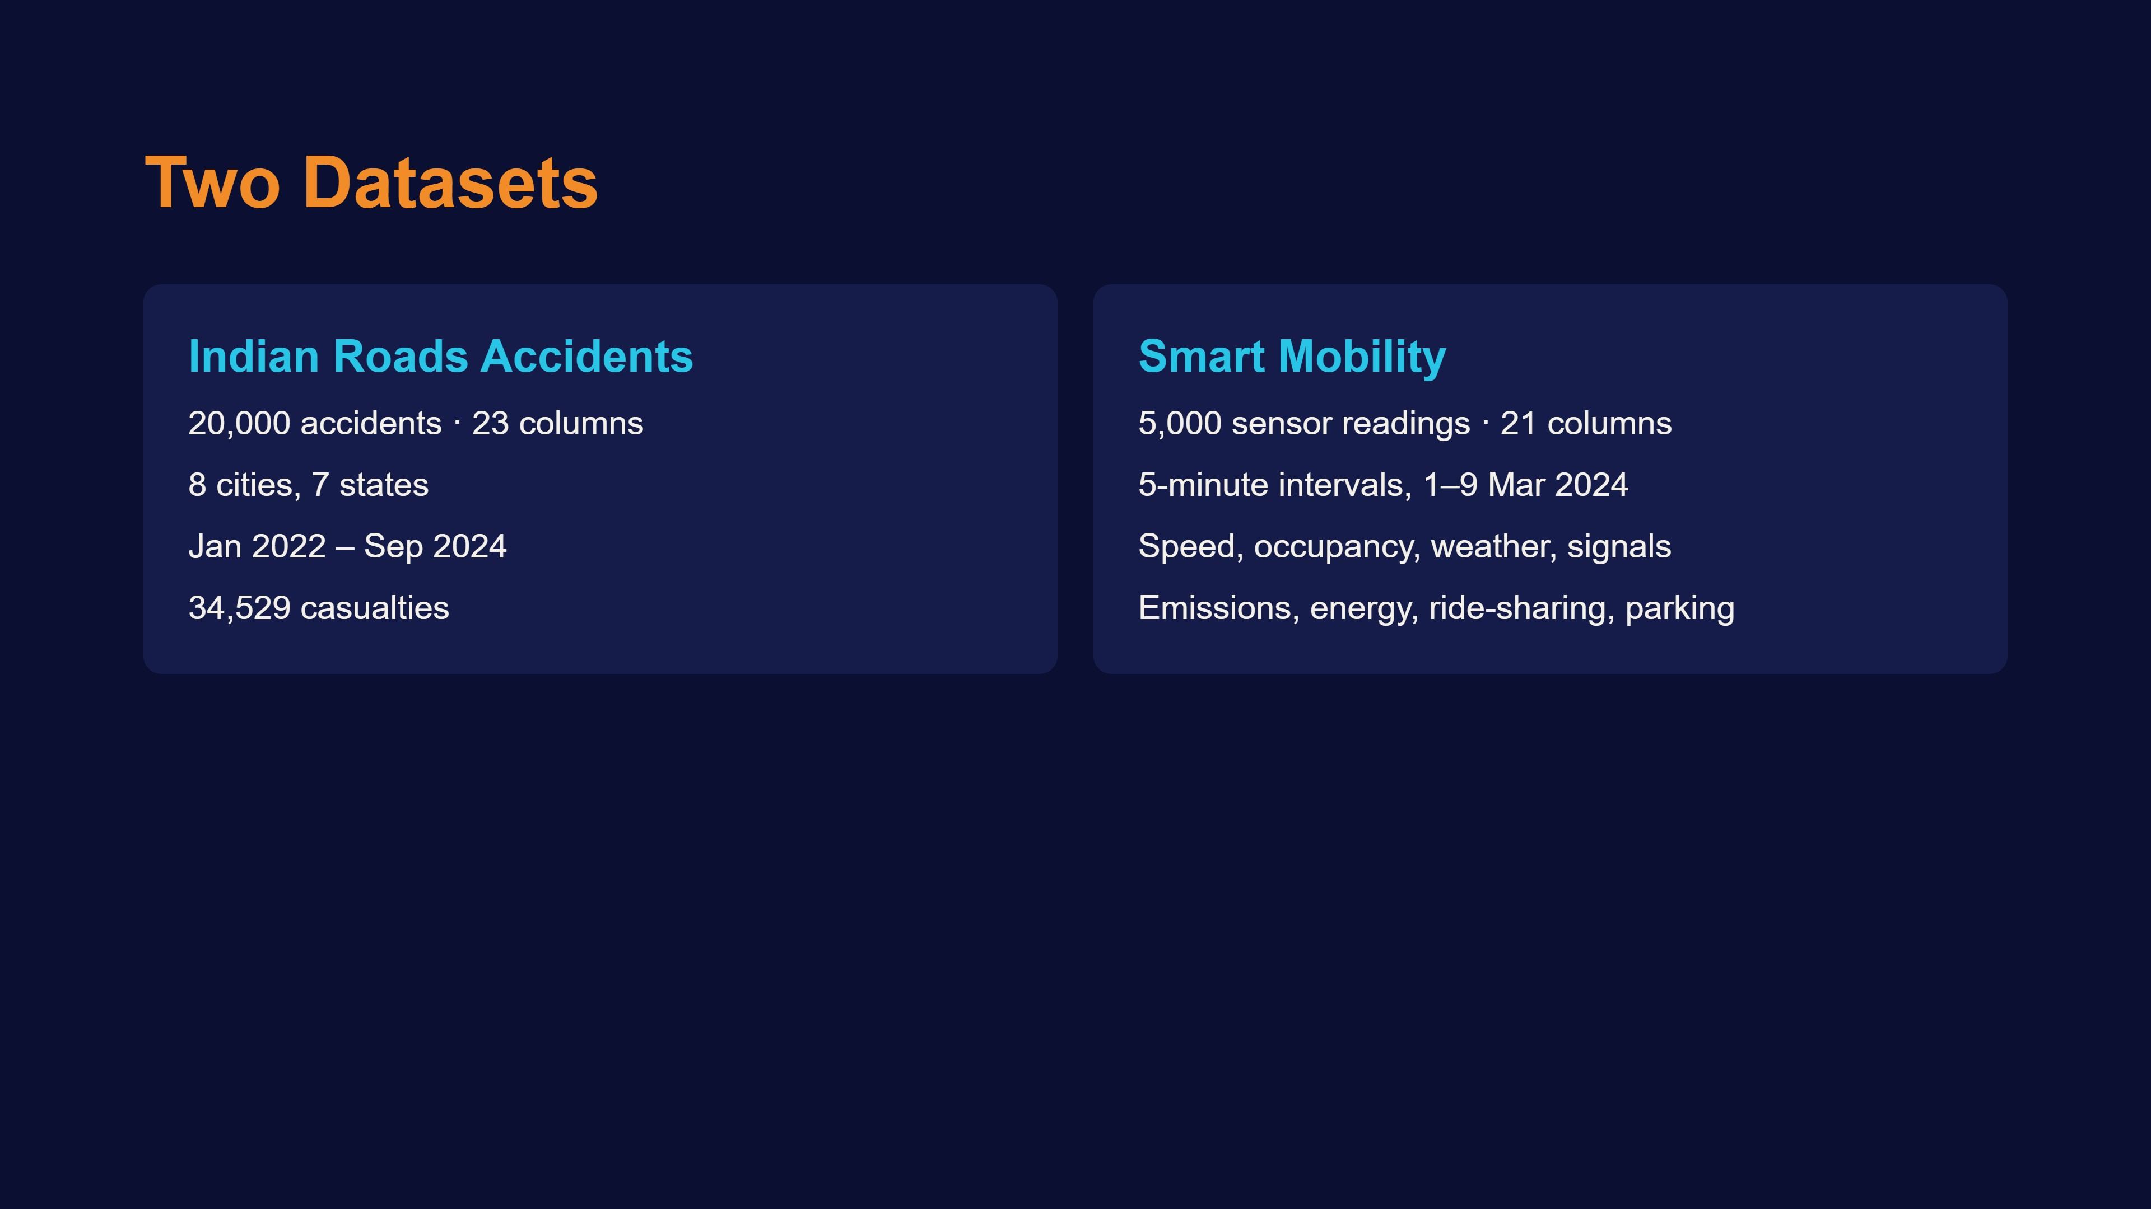
Notes:
Dono datasets alag hain, common key nahi hai.

Slide 4
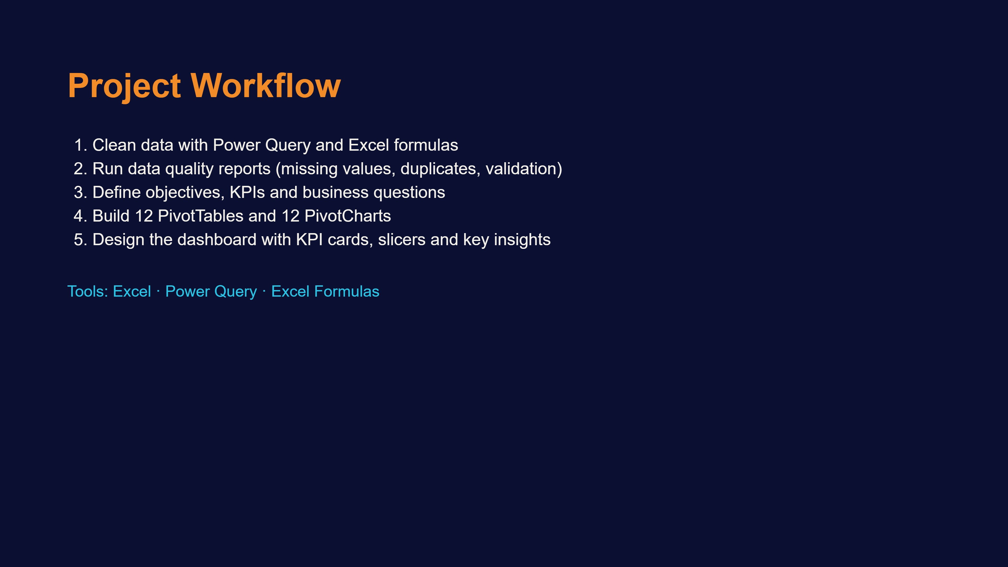
Notes:
Step by step process samjhao.

Slide 5
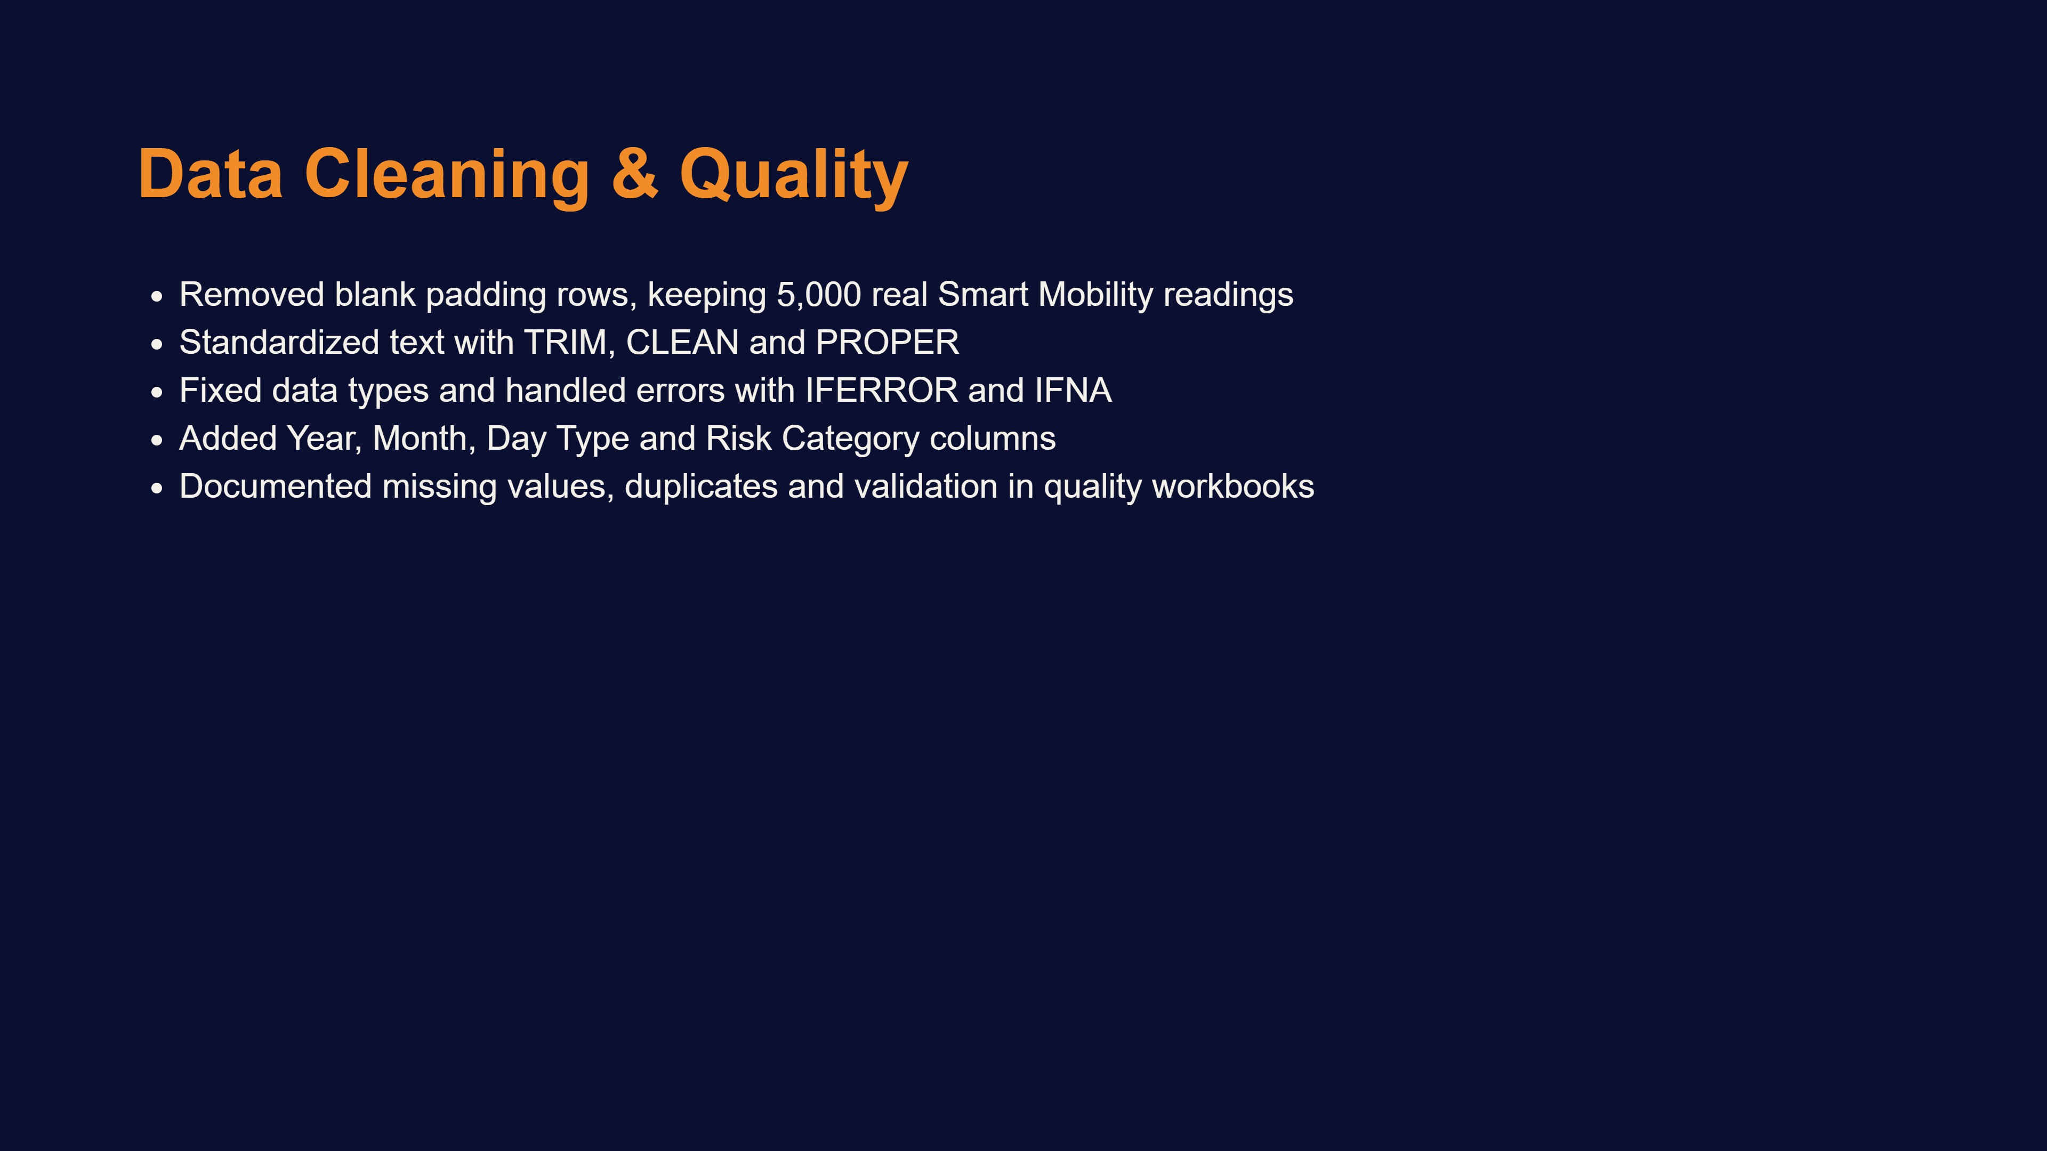
Notes:
Cleaning ka kaam aur kaunse formulas use kiye.

Slide 6
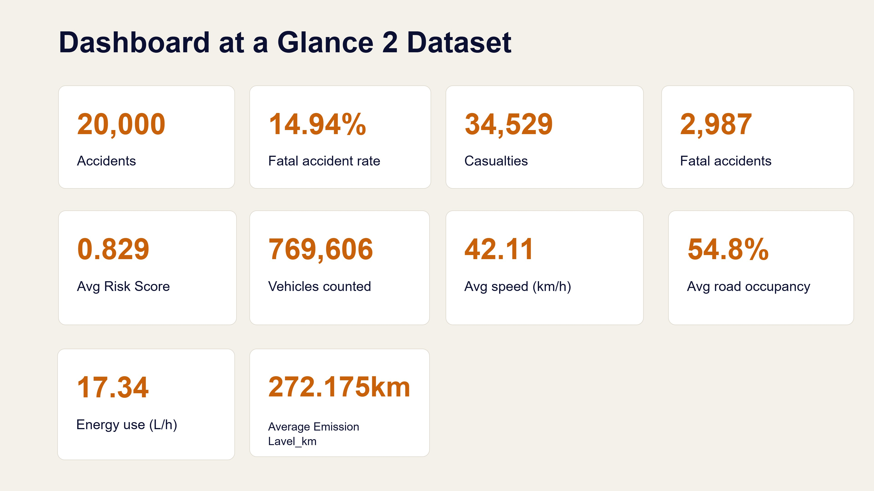
Notes:
Top KPI cards: pehli row road safety, doosri traffic.

Slide 7
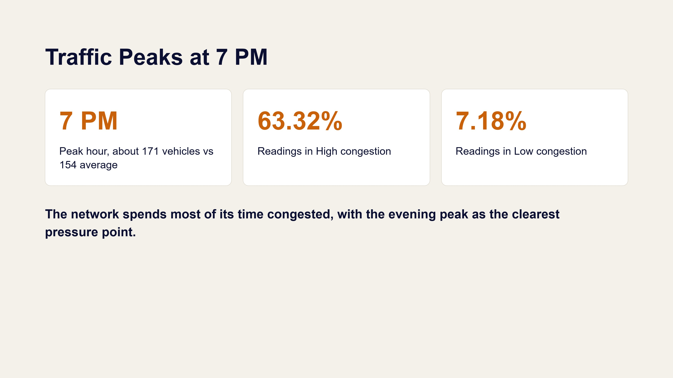
Notes:
Traffic Volume by Hour aur Condition Distribution charts.

Slide 8
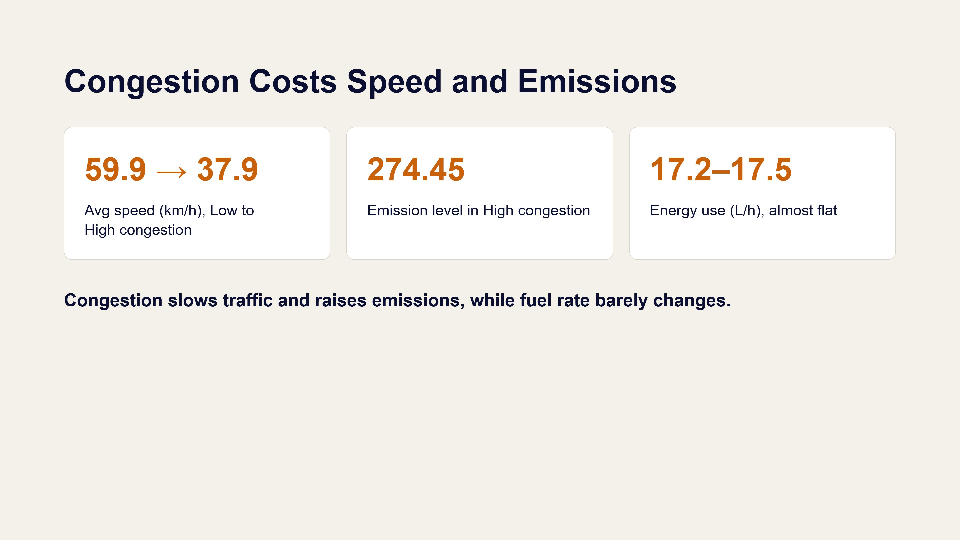
Notes:
Speed, emission aur energy by traffic condition.

Slide 9
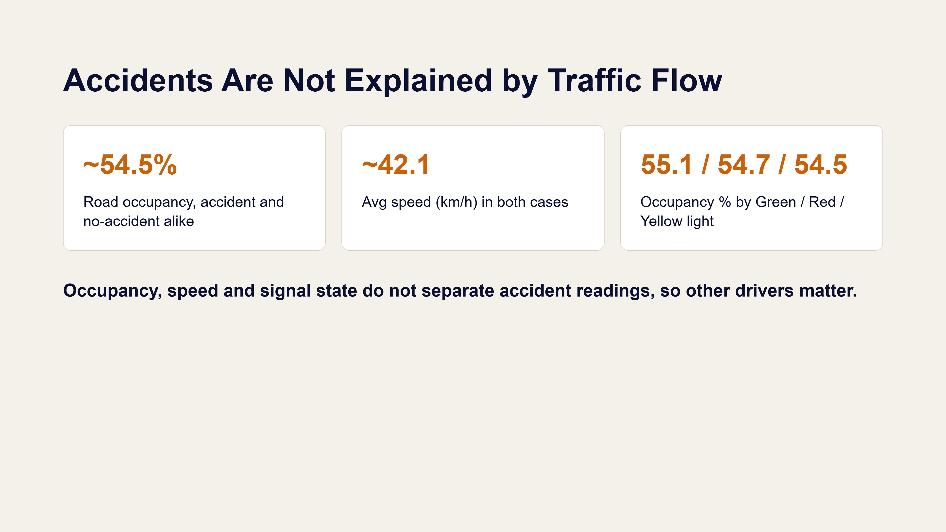
Notes:
Yahan bolo ki flow se accident predict nahi hota.

Slide 10
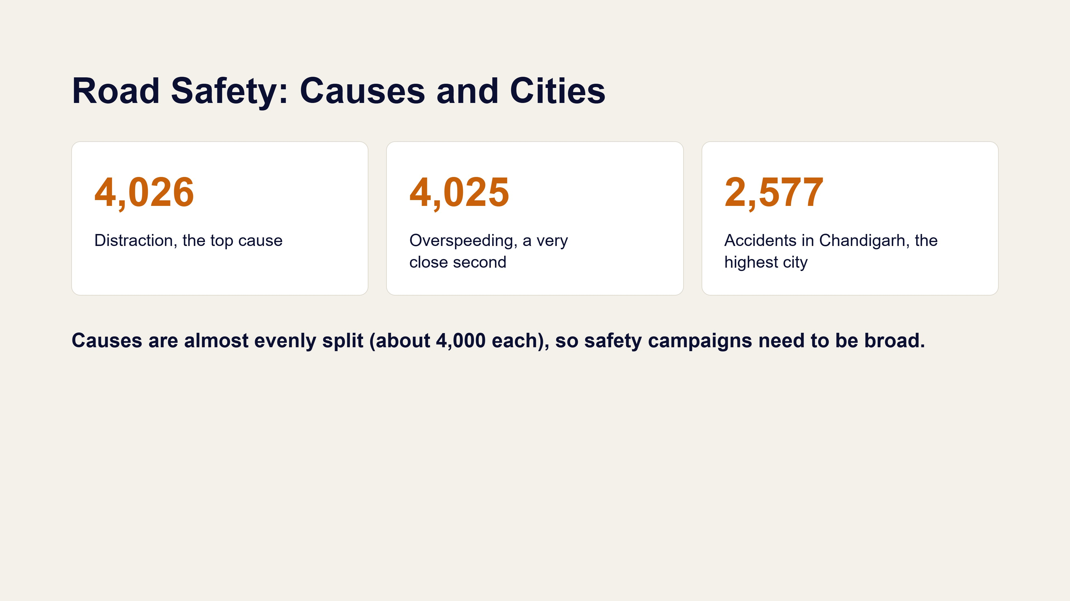
Notes:
Accidents by Cause aur by City charts.

Slide 11
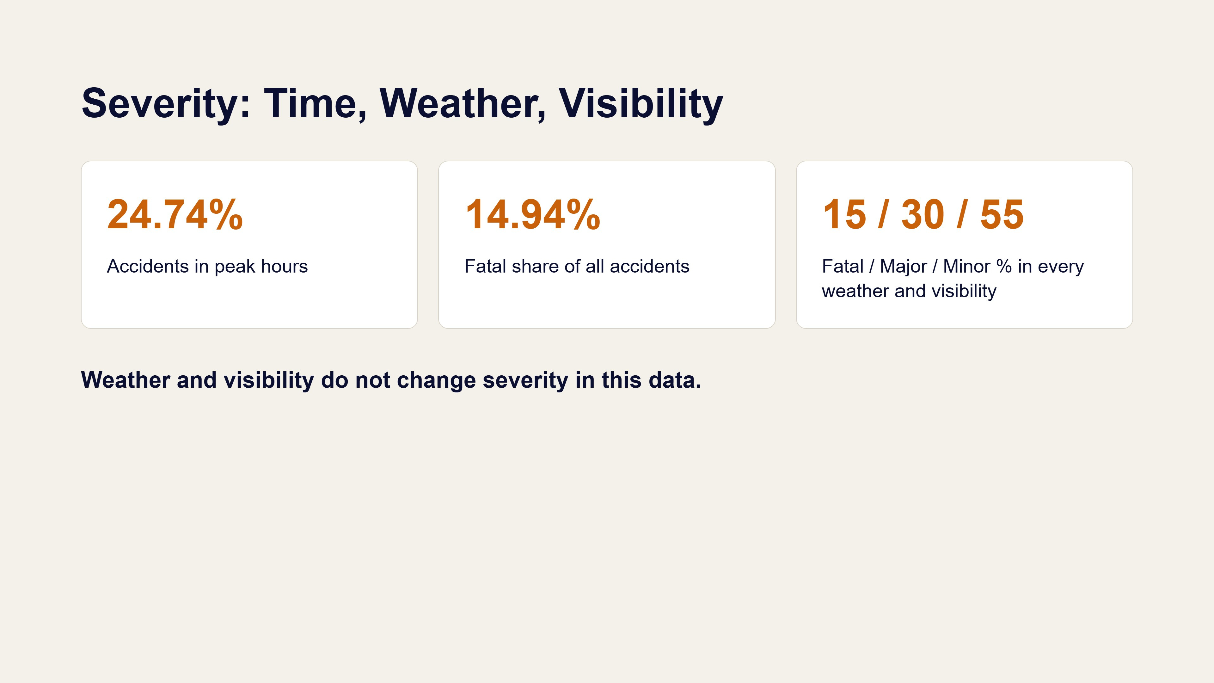
Notes:
Weather aur visibility ka severity par asar nahi dikha.

Slide 12
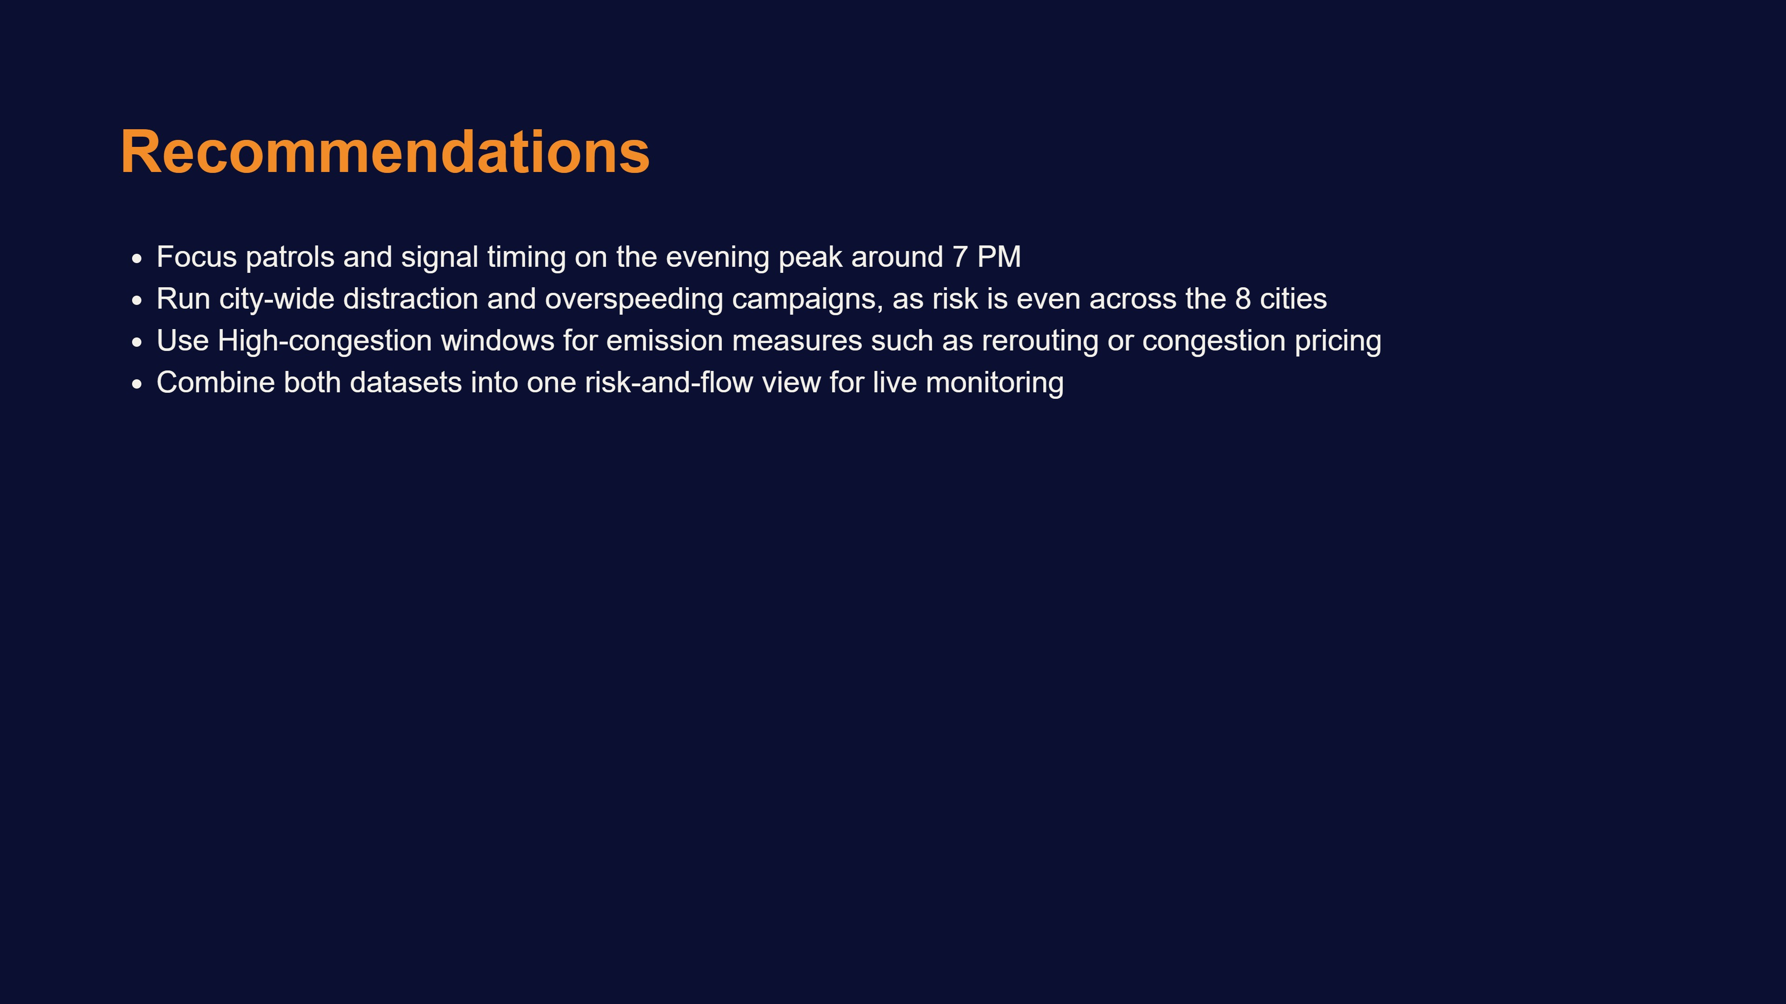
Notes:
Actionable recommendations, interview ka sabse important slide.

Slide 13
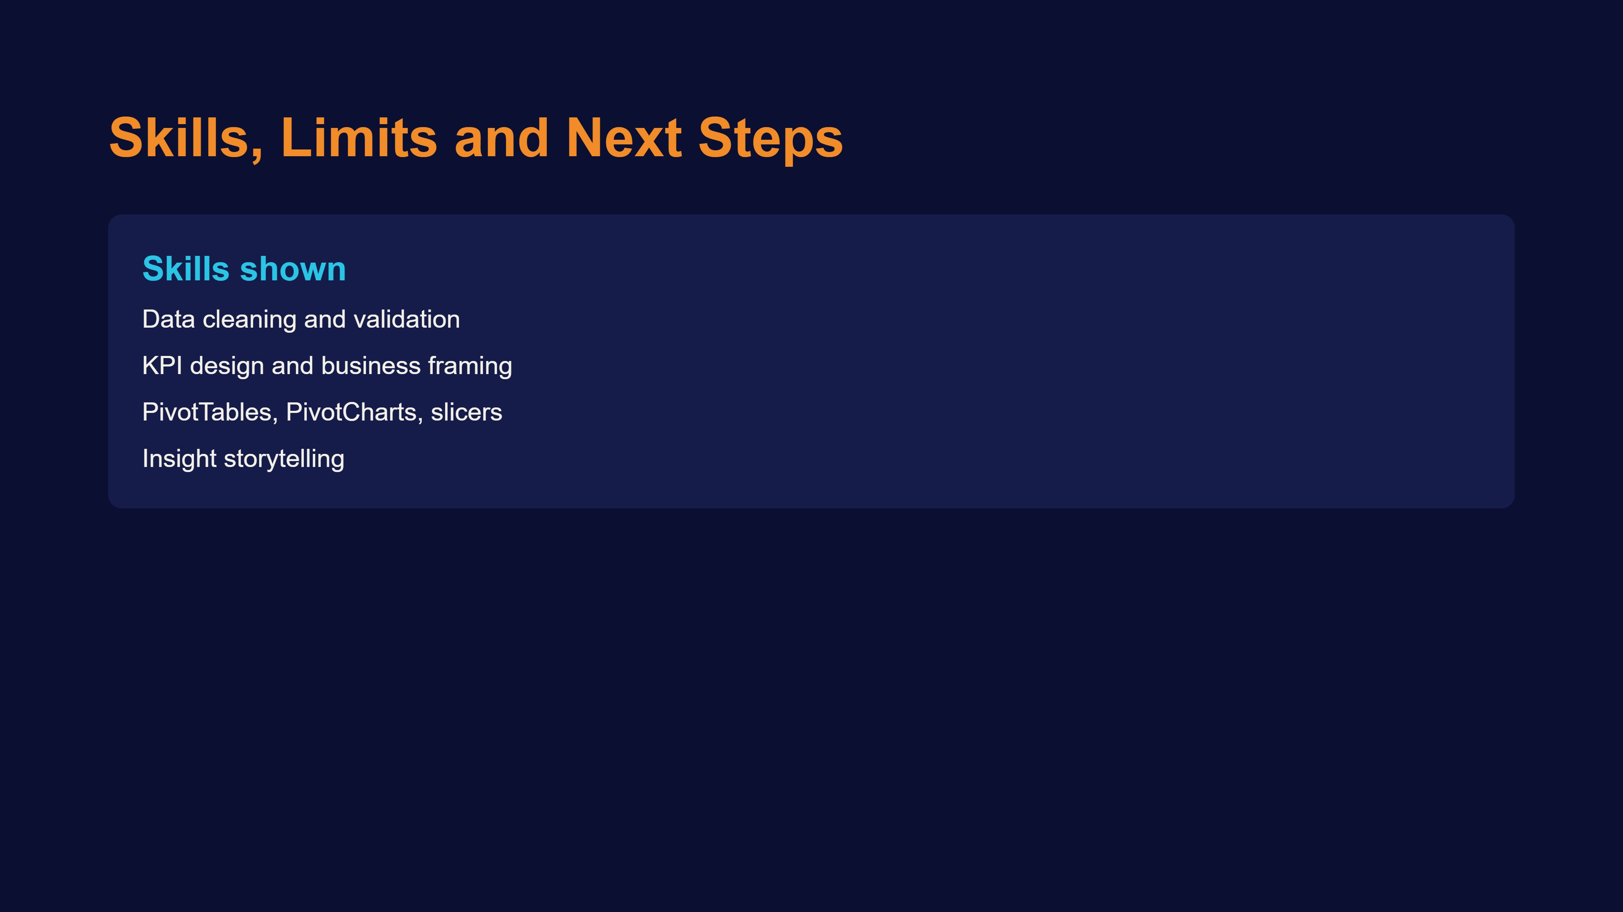
Notes:
Limitations honestly batao, interviewer ko achha lagta hai.

